Slide 1
Neurology

Slide 2
Introduction and Organization

Slide 3
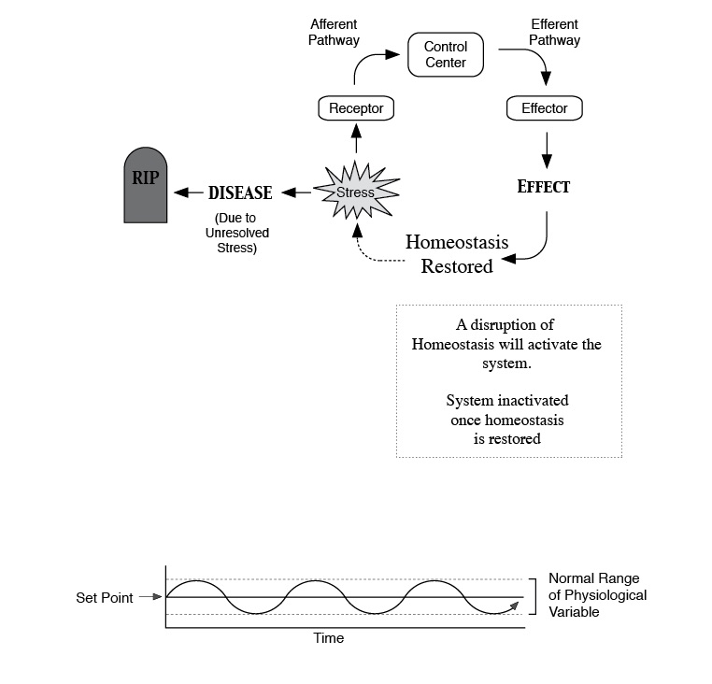

Slide 4
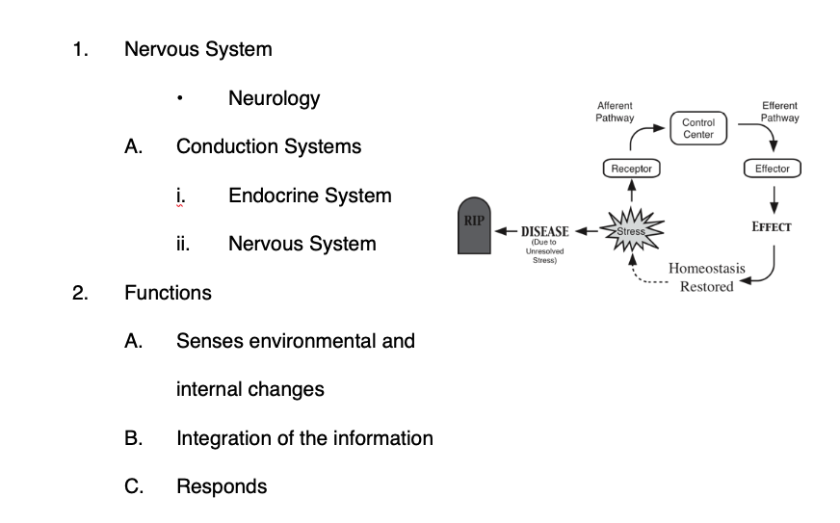

Slide 7
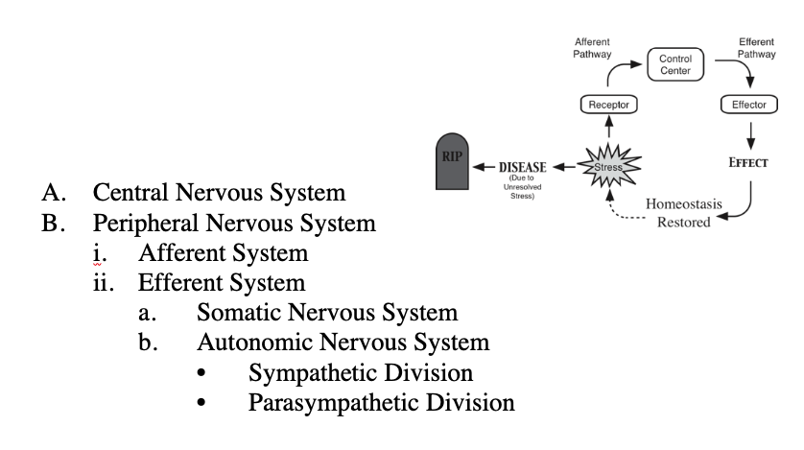

Slide 9
Neuroglia

Slide 11
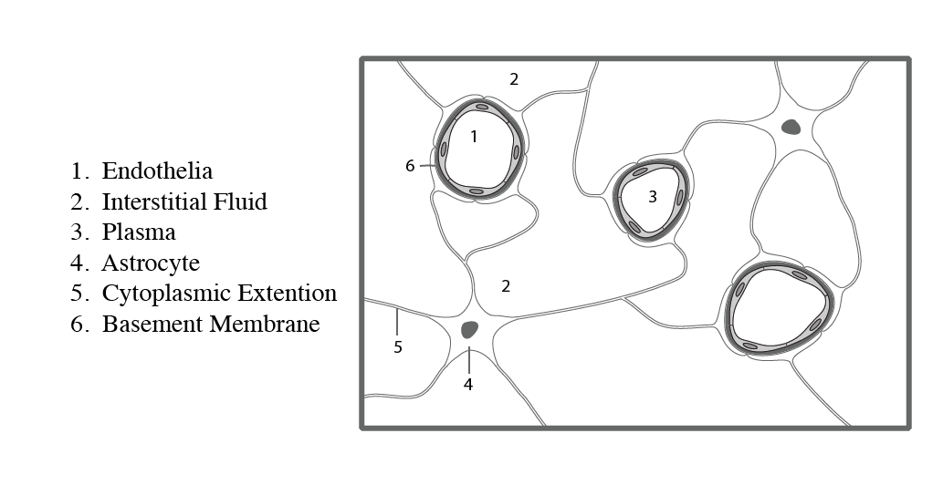

Slide 18
Neuron Anatomy

Slide 26
Neuron Classification

Slide 27
Classification Schemes:
• Presence of Myelin
• Structural Characteristics
• Functionally

Slide 31
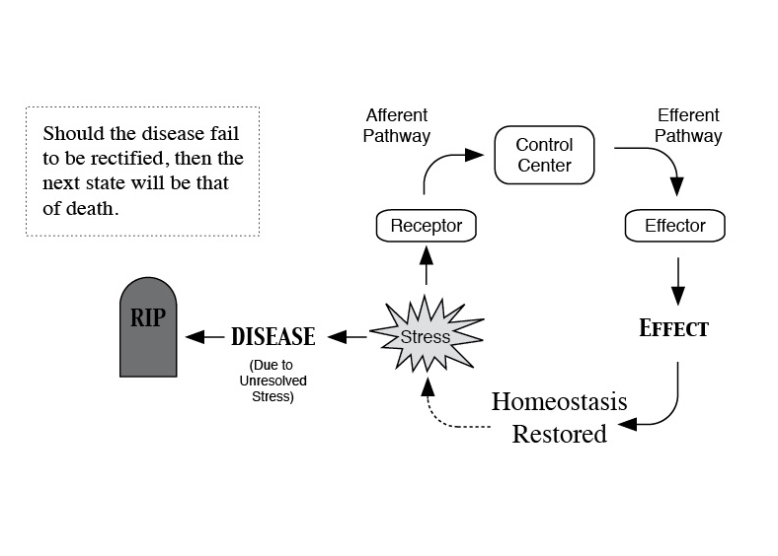

Slide 33
Nerve Processes

Slide 39


Slide 40
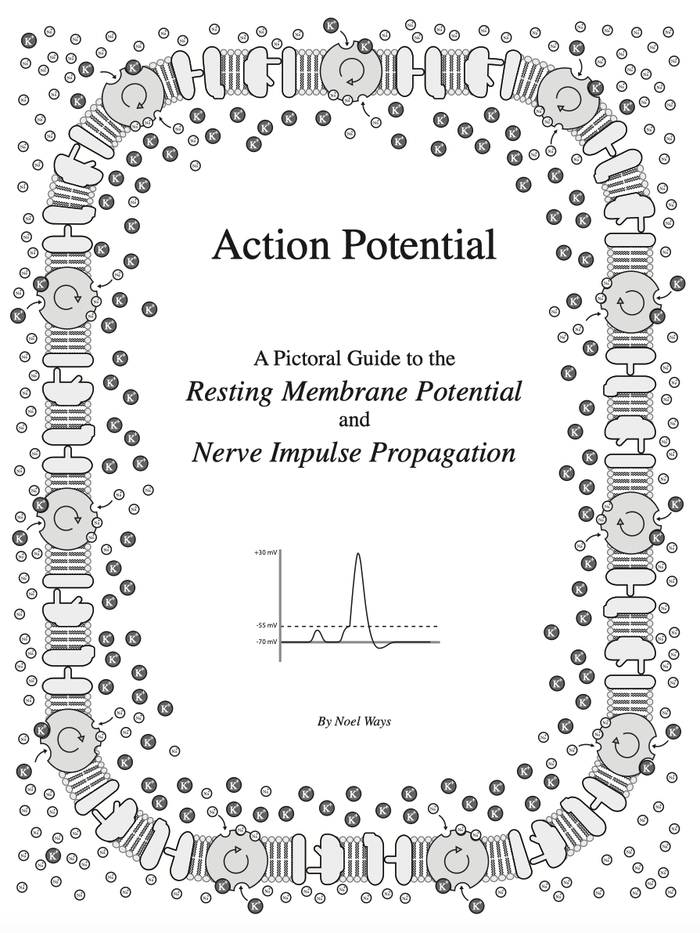

Slide 41
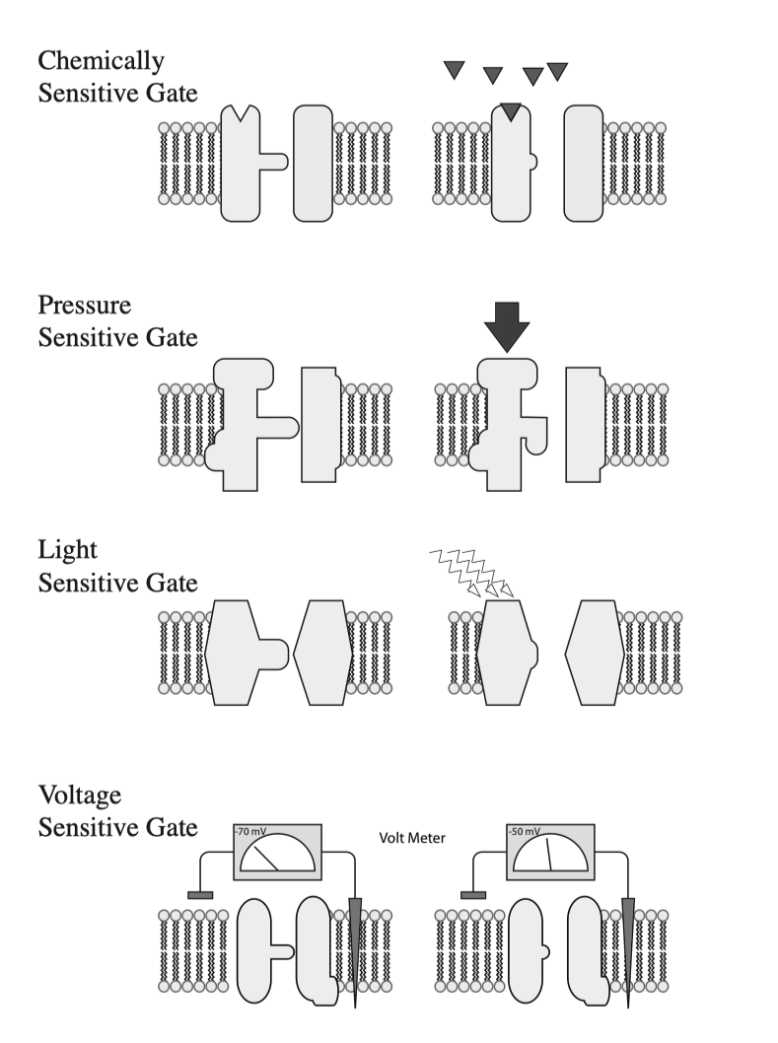

Slide 42
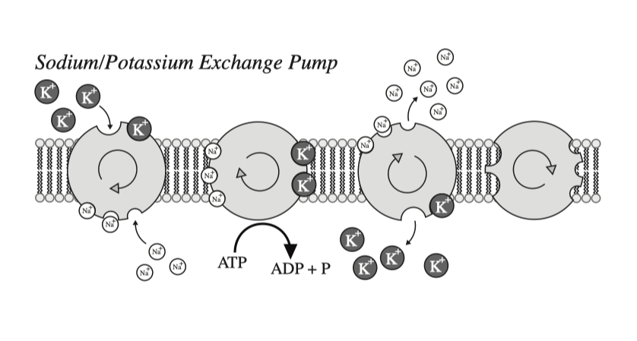

Slide 43
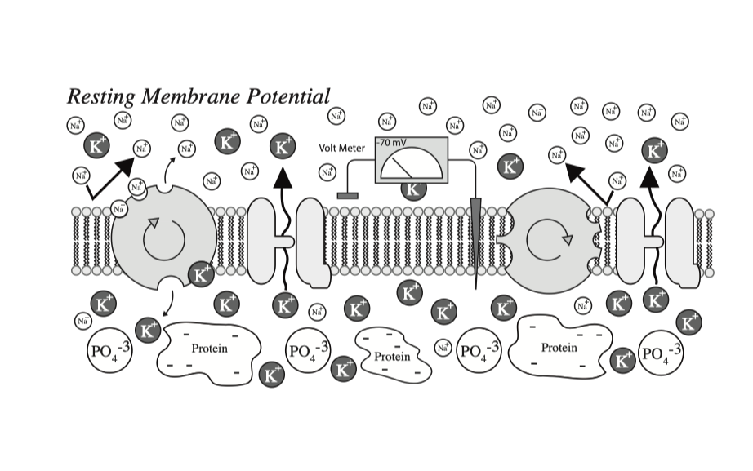

Slide 45


Slide 46
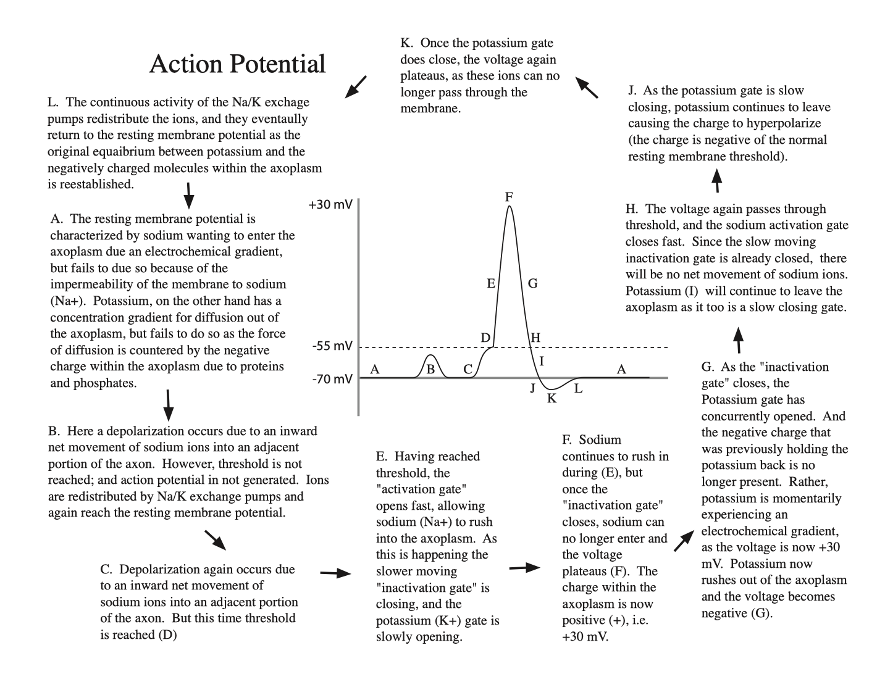

Slide 48


Slide 51
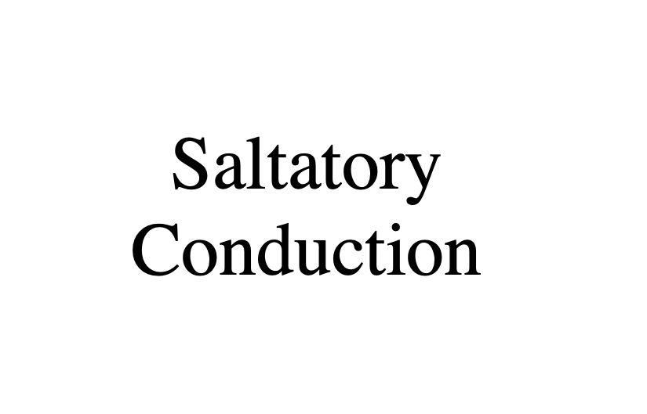

Slide 55


Slide 56
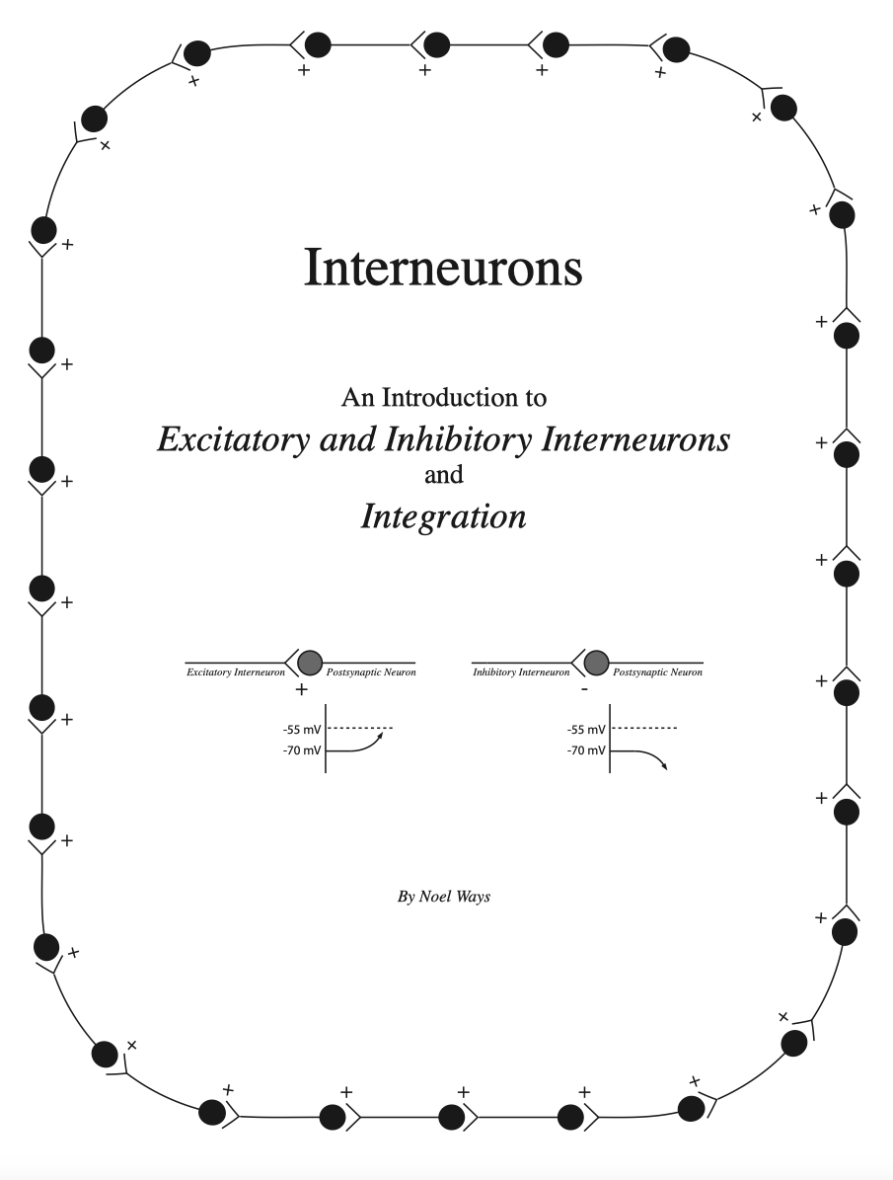

Slide 57
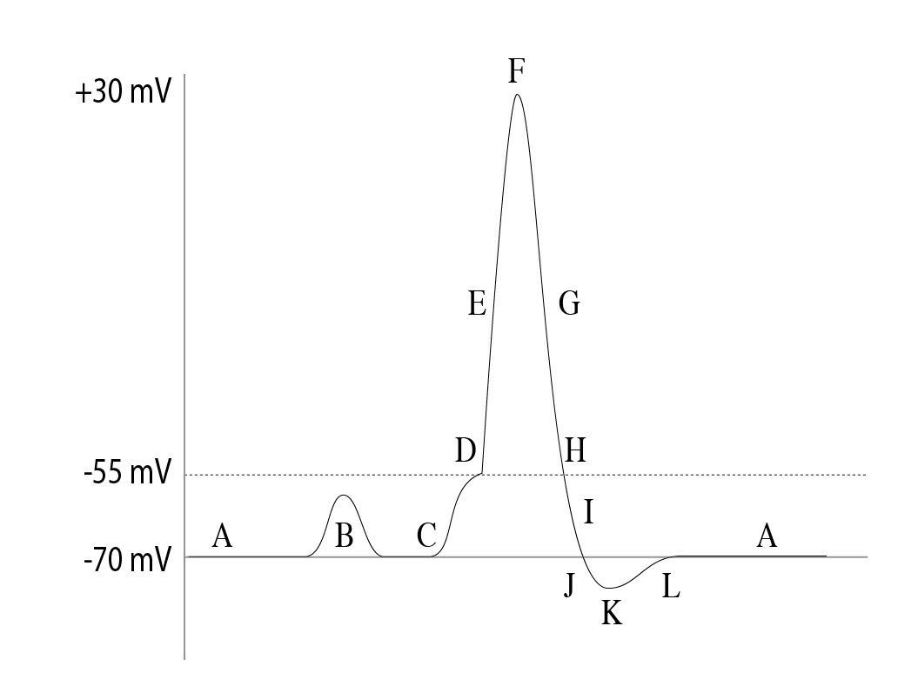

Slide 58
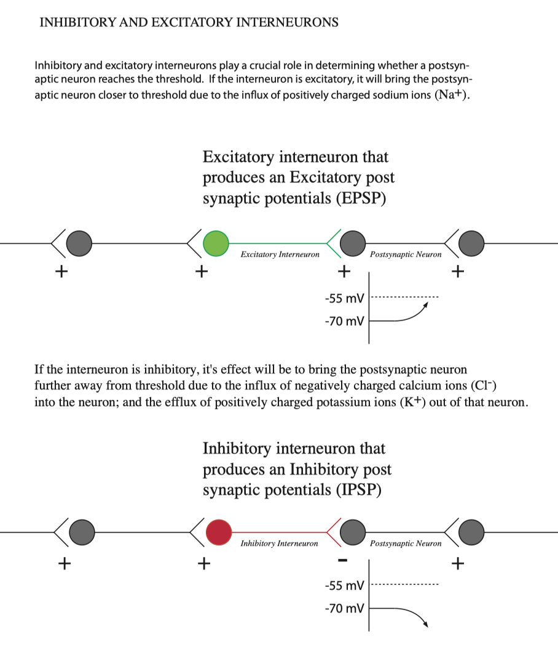

Slide 59
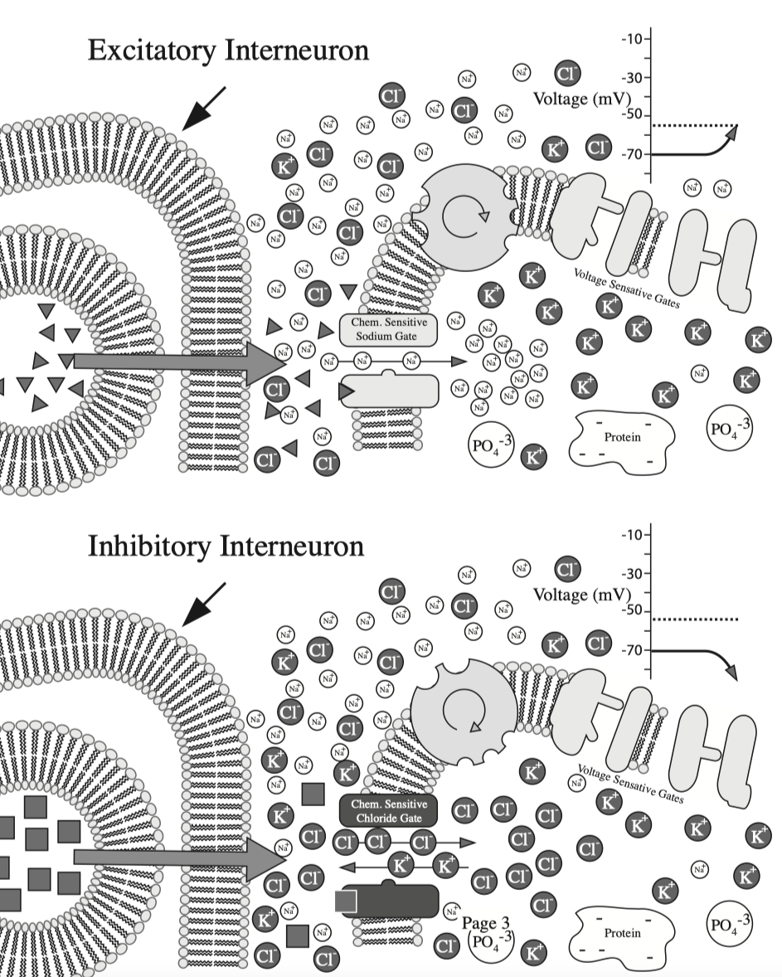

Slide 60
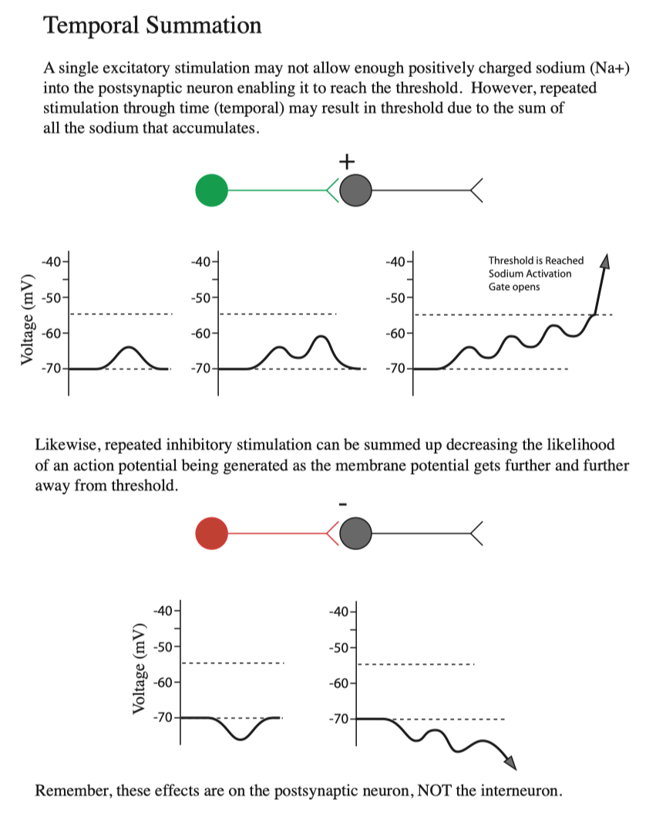

Slide 61
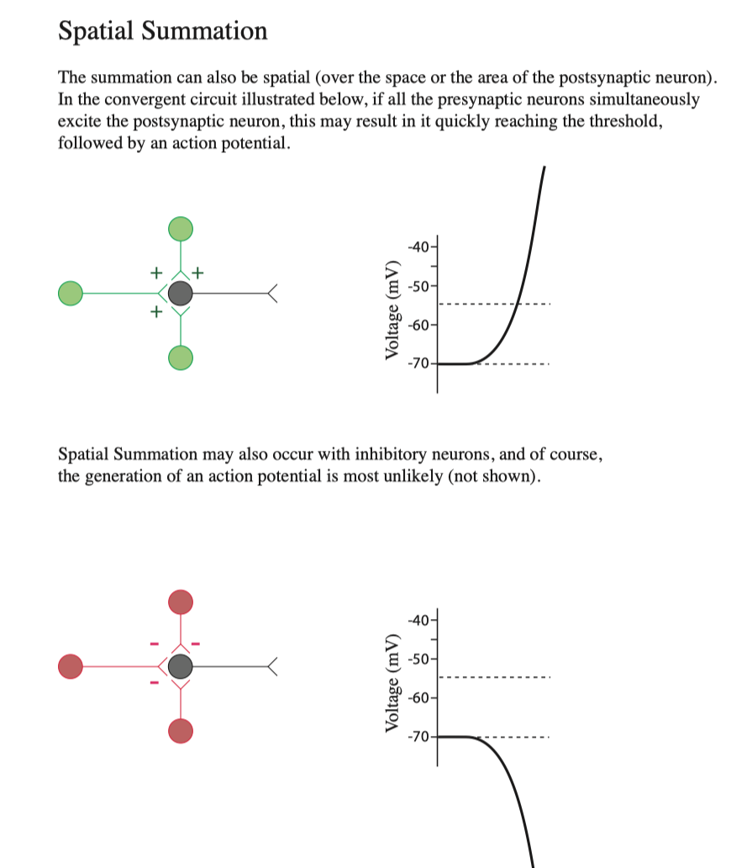

Slide 62
